Slide 1
Term Project Final
Team 3

Slide 2
Outline
Introduction
Objectives
Algorithm Implementation
Performance Evaluation
Conclusion

Slide 3
Introduction
Aggregation is one of the most common workload for database systems
In SimpleDB, aggregation is already implemented based on MergeSort (external sort)

Slide 4
Introduction
The aggregation algorithm in the SimpleDB distribution code is just an basic implementation
Aggregation is based on 2-way merge sort
Splitting into runs does not consider anything about buffers
Split is based on the order of the tuples
Performance is very poor
Takes tens of minutes to perform GROUP BY on 5000 tuples

Slide 5
Objectives
Improve MergeSort GROUP BY
By implementing multi-buffer sorting
See section 23.4.2 in the textbook
Implement Hash GROUP BY
Hash GROUP BY is known to perform better than Sort GROUP BY in many cases
Compare the performance of MergeSort GROUP BY and Hash GROUP BY
Only GROUP BY
GROUP BY along with ORDER BY

Slide 6
Algorithm Implementation
Improving MergeSort GROUP BY
Implementing Hash GROUP BY

Slide 7
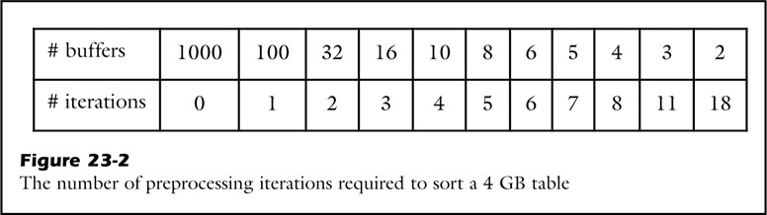
Improving MergeSort GROUP BY
In simpleDB, MergeSort GROUP BY is implemented
2-way merge sort
Multi-buffer is not considered
Multi-buffer sorting is more efficient

Slide 8
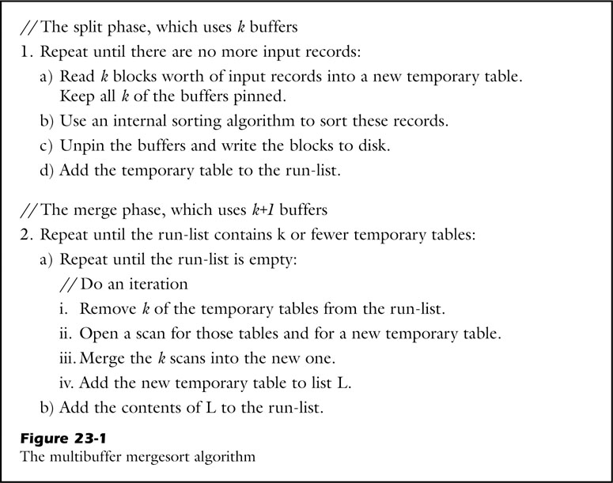
Improving MergeSort GROUP BY
Implementing multi-buffer sorting
MultiBufferSortPlan
MultiBufferSortScan

Slide 9
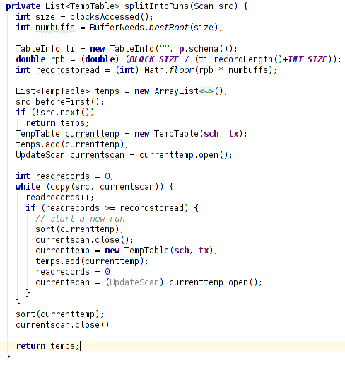
Improving MergeSort GROUP BY
Use k buffers to splitting into runs
Determine k : the best number of buffers
Determine k blocks worth records
Copy k blocks worth records to a temp table

Slide 10
Improving MergeSort GROUP BY
Implementing multi-buffer sorting
MultiBufferSortPlan
MultiBufferSortScan

Slide 11
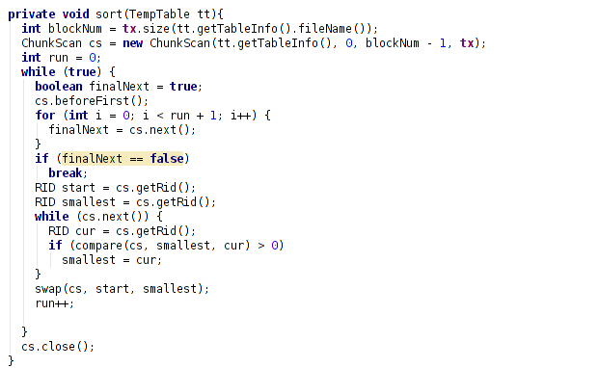
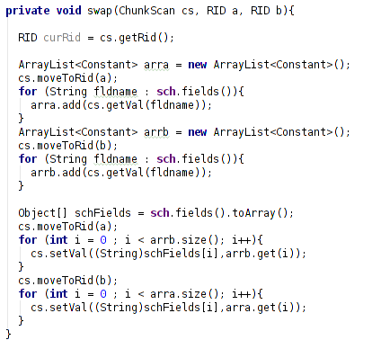
Improving MergeSort GROUP BY
Internal insertion sort

Slide 12
Improving MergeSort GROUP BY
Implementing multi-buffer sorting
MultiBufferSortPlan
MultiBufferSortScan

Slide 13
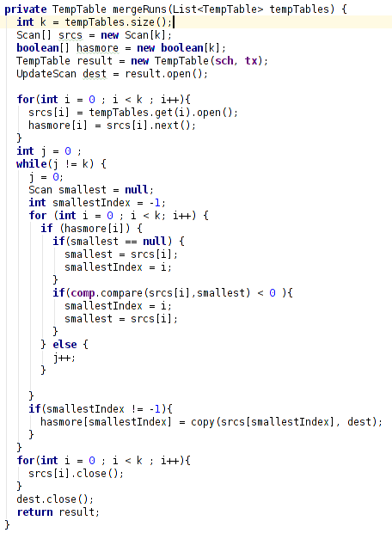
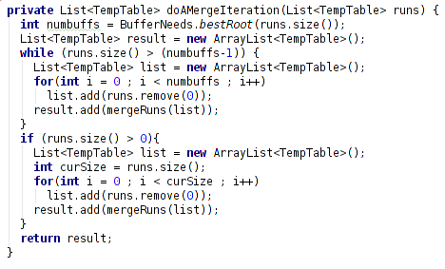
Improving MergeSort GROUP BY
These two methods are modified to support merging k runs

Slide 14
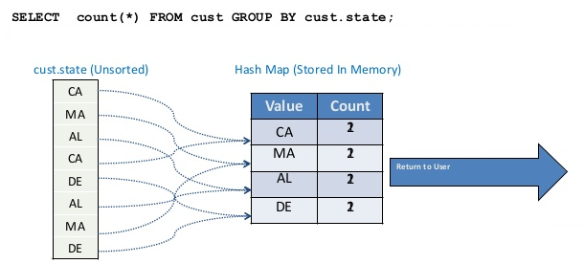
Implementing Hash GROUP BY
Example of Hash GROUP BY

Slide 15
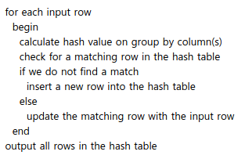
Implementing Hash GROUP BY
Implementing Hash GROUP BY
HashGroupByPlan
HashGroupByScan
The Hash Group By algorithm

Slide 16
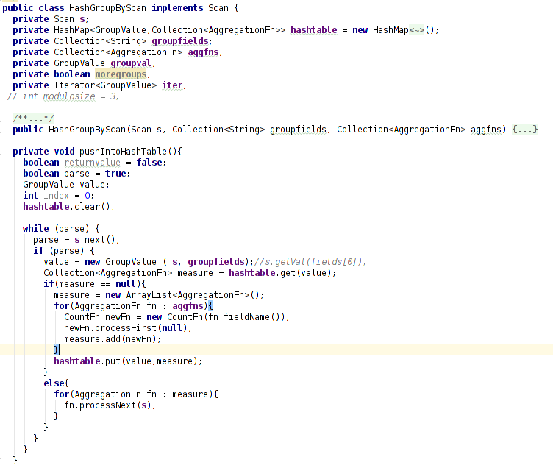
Implementing Hash GROUP BY
creating in-memory hash table
from the original table

Slide 17
Performance Evaluation
Environments
Base source code – SimpleDB 2.10
Block size – 4KBytes
Number of blocks – 1024
Data
Generate table contains random integers
3 tables, (each table has only 1 column)
250,000 tuples, cardinality 1000, uniform distribution
250,000 tuples, cardinality 5000, uniform distribution
250,000 tuples, cardinality 10000, uniform distribution

Slide 18
Performance Evaluation
Comparison
Sort GROUP BY (multibuffer sort) vs Hash GROUP BY
Sort GROUP BY (multibuffer sort) vs (Hash GROUP BY + ORDER BY)

Slide 19
Performance Evaluation
Sort GROUP BY vs Hash GROUP BY
Input 250,000

Slide 20
Performance Evaluation
( Sort GROUP BY ) vs ( Hash GROUP BY + ORDER BY )
Input 250,000

Slide 21
Conclusion
We improved sorting algorithm in SimpleDB
We improved sort GROUP BY performance
We improve GROUP BY performance by implementing hash GROUP BY algorithm
In our experiments, hash GROUP BY worked extremely faster then sort GROUP BY
Furthermore, hash GROUP BY outperformed sort GROUP BY even though sorted output is required

